Slide 1


Enhancing Cattle Health Monitoring through
ML-Based Disease Detection and AI-Driven
Treatment Recommendation
Presented by,
Krishnendu Lal
PG Scholar
Guide,
Mr. Amal K Jose
Assistant Professor

Slide 2
CONTENTS
ABSTRACT
LITERATURE SURVEY
INTRODUCTION
METHODOLOGY
RESULTS AND DISCUSSION
FUTURE SCOPE
CONCLUSION
REFERENCES

Slide 3
ABSTRACT
Key Features:
AI-driven real-time cattle disease detection.
Uses CNN based machine learning.
Integrates AI for disease information.
Diagnosis Accuracy:
Achieves good precision in disease identification.
Improves management effectiveness.
Improved Accessibility:
Enables instant image-based diagnosis for farmers.
Beneficial for remote farms with limited veterinary access.

Slide 4
LITERATURE SURVEY
Review on cattle breed and skin disease detection using deep learning:
Highlights the importance of image-based disease detection.
2. Disease detection using VGG16 CNN architecture:
Demonstrates accuracy in disease identification, emphasizing the effectiveness of CNNs in veterinary applications.
3. Transfer learning for detecting animal diseases from images:
Explores transfer learning techniques to improve disease detection with pre-trained models.

Slide 5
LITERATURE SURVEY
Case-based reasoning and KNN similarity methods for cattle diagnosis:
Proposes a case-based reasoning (CBR) approach where past disease cases help diagnose new instances.
5. Feature selection and KNN for cow disease diagnosis:
Investigates feature selection techniques to improve the accuracy of KNN-based classification for cow diseases.
6. CNN and SVM-based cattle disease classification:
Achieves robust disease identification, showing that hybrid AI models can improve veterinary diagnostics.

Slide 6
INTRODUCTION
Challenges in livestock disease detection:
Late diagnosis, economic loss, and animal welfare issues.
Limitations of traditional methods:
Manual observation and high treatment costs.
Proposed solution:
AI-driven CNN-based disease detection.
Real-time analysis and instant treatment recommendations.
To ensure our model runs efficiently even on low-end devices, we have used MobileNetV2, a lightweight deep learning model optimized for mobile and edge devices.

Slide 7
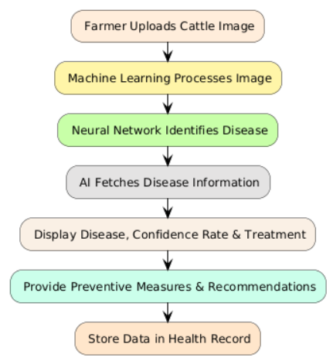
METHODOLOGY
Data Collection:
Images sourced from datasets.
Model Training:
CNN-based deep learning model for disease identification.
Using MobileNetV2 for Disease Classification:
It is Lightweight and Fast
Pretrained Model, Trained on ImageNet.
Disease Detection Process:
Farmers upload images via a user-friendly interface.
Image is analysed using trained models.
AI provides additional disease-related information.
Health Record Management:
Centralized database for pattern recognition and history storing.

Slide 8
RESULTS AND DISCUSSION
Performance Metrics:
Over 85% precision in disease detection.
2.5x faster diagnosis compared to traditional methods.
Impact:
80% improvement in disease management.
Reduces the time gap between symptom detection and treatment.
Provides cost-effective veterinary solutions to farmers.

Slide 9
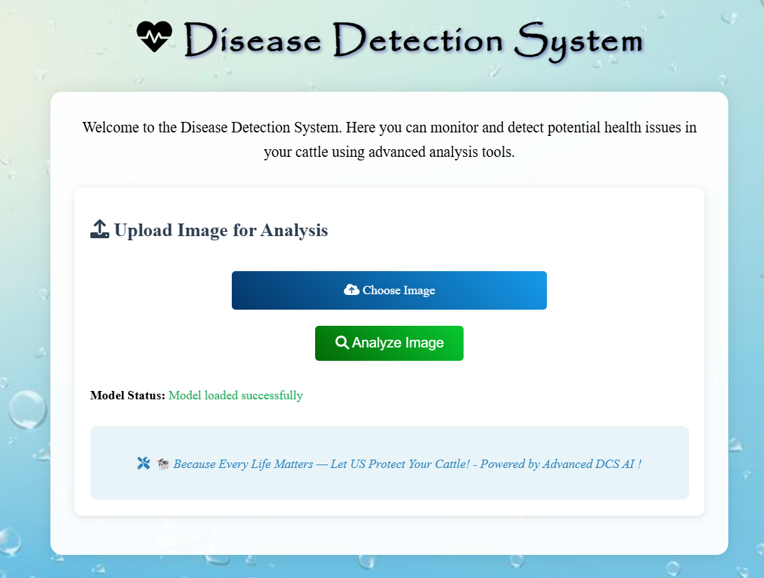
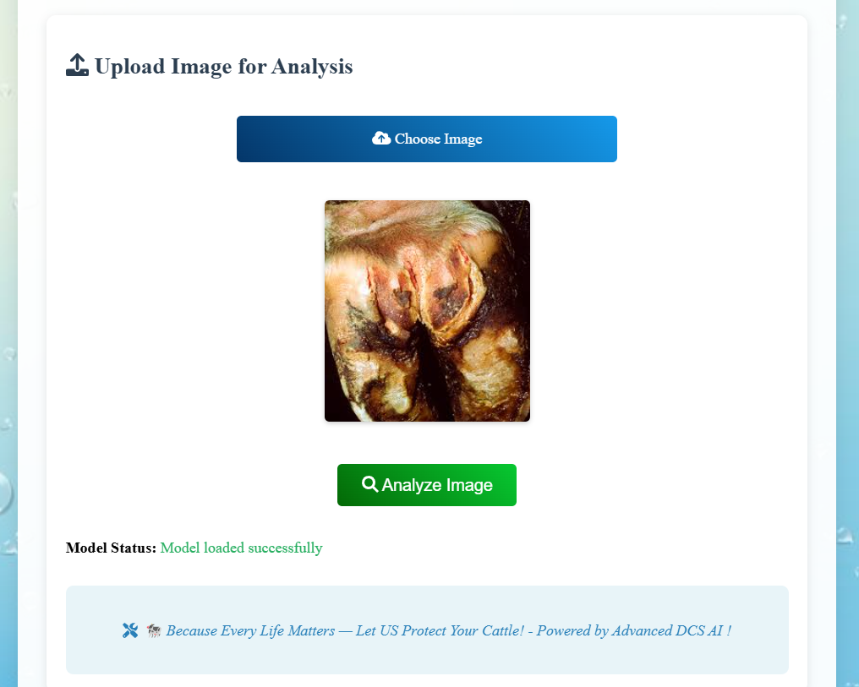
RESULTS AND DISCUSSION

Slide 10
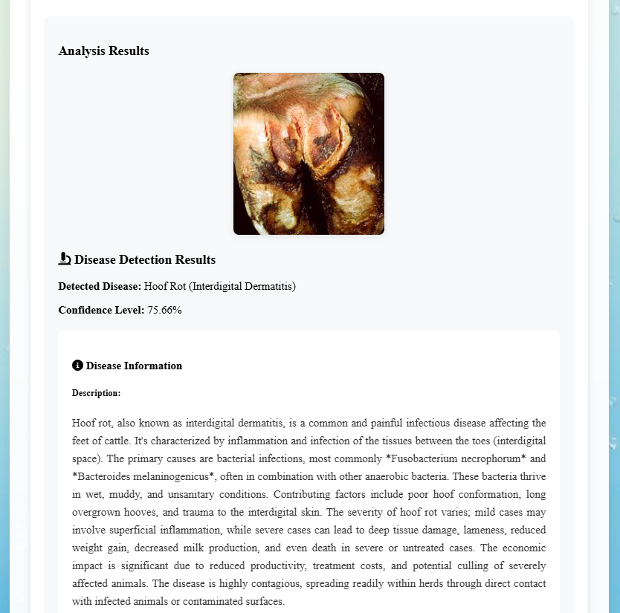
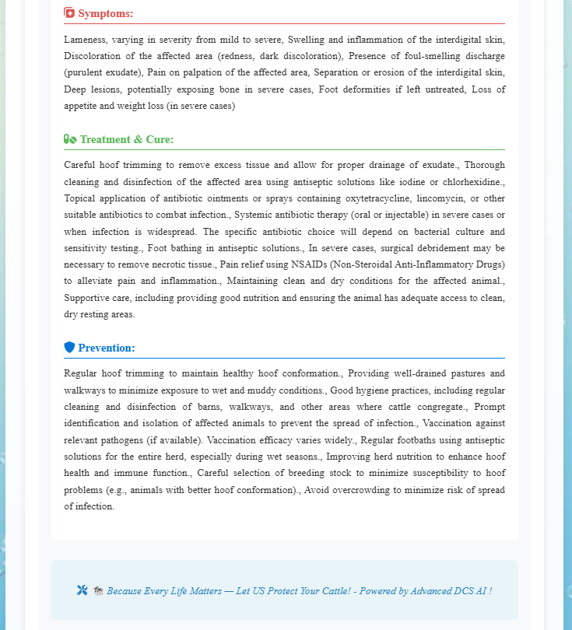
RESULTS AND DISCUSSION

Slide 11
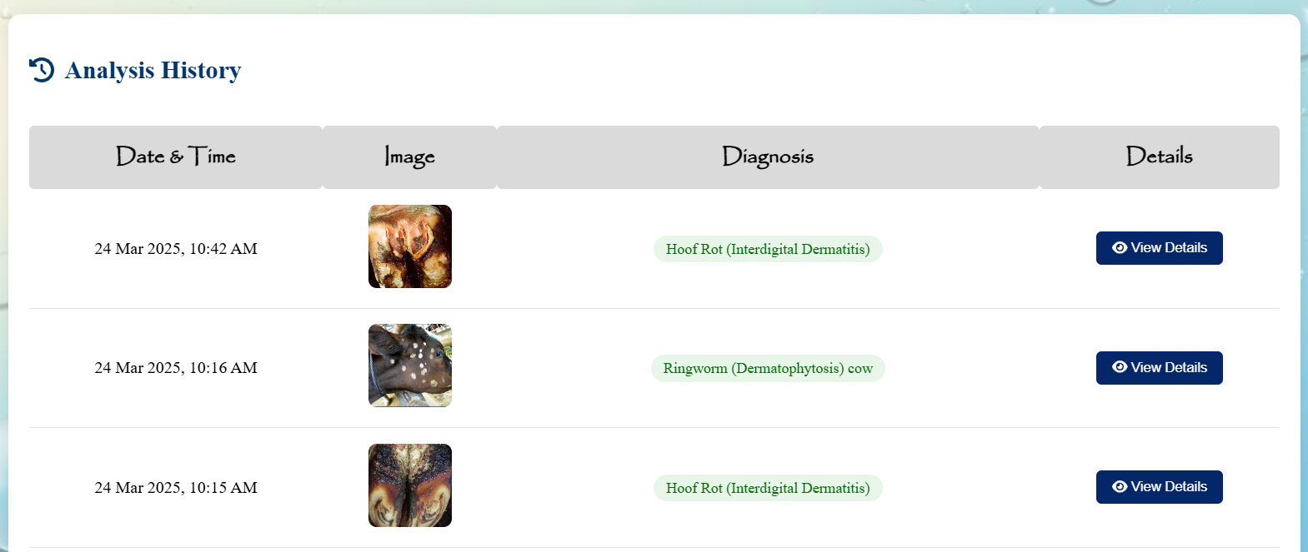
RESULTS AND DISCUSSION

Slide 12
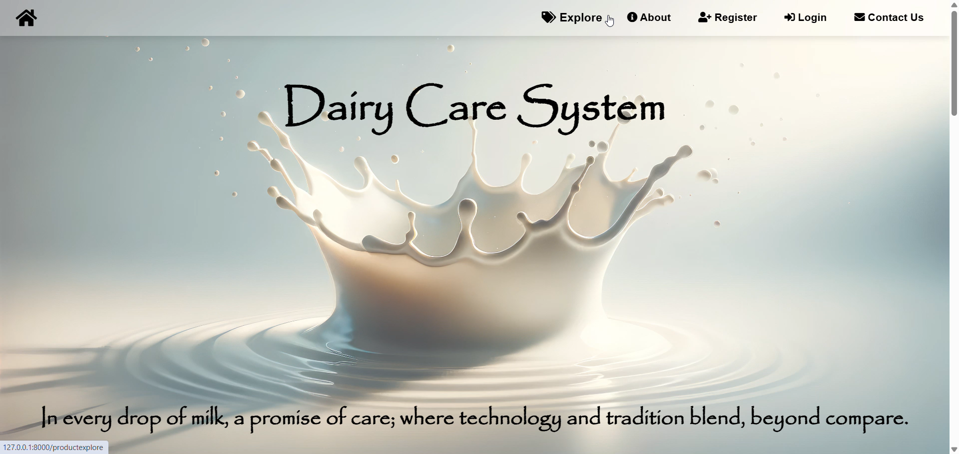

Slide 13
FUTURE SCOPE
Expanding the dataset for more cattle breeds and diseases.
Integration of AI-powered chatbots for veterinary guidance.
Enhancing mobile accessibility for remote farmers.
Incorporating predictive analytics for early disease warning.

Slide 14
CONCLUSION
ML and AI powered real-time disease detection enhances dairy farming.
Faster diagnosis reduces economic losses and improves animal health.
Automated treatment recommendations support farmers in isolated areas.
Demonstrates scalability and adaptability for future advancements.

Slide 15
REFERENCES
K. Tikarya et al. (2023) – Cattle disease identification using deep learning.
S. Shinde et al. (2024) – VGG16-based cattle disease detection.
A. Khan et al. (2023) – Transfer learning for animal disease detection.
D. R. Anamisa et al. (2022) – Case-based reasoning for cattle disease diagnosis.
Y. Kustiyahningsih et al. (2021) – KNN-based diagnosis for cow diseases.
S. Mehta & R. Saini (2024) – CNN and SVM for cattle disease classification.

Slide 16
THANK YOU

